Slide 1
Industry Management System
Foram Nandasana
D21IT177

Slide 2
Definition
Industry management system is computerized systems [implemented using tablets (Industrial PC)].
Everywhere time plays vital role, In industries mostly all factory floor working is done on papers only which is time consuming, untidy and has lack of availability resources sometimes which reflects bad management of company.

Slide 3
So, In the existing system all the information is totally based on paper. It will take more man power and it will take more time. The redundancy of data is to be maintained.
So, In Industry management system Provide overall control and management of the factory floor and its inventory.
It handles customer’s detail, order , send production request to the factory floor.

Slide 4
Development Tools and Technologies
Front End
HTML , CSS and JavaScript
Back End
Python and MySQL

Slide 5
System Analysis
General Description
In this system, The dealer details, order details, factory floor details, employee details, inventory details, row material details and a Production Schedule Report will be generated.

Slide 6
Features
Admin
Admin Registration
Login
Manage Profile
Add Supervisor and Worker
Manage Supervisor Task
Manage Client
Manage Row Material
Manage Products
Logout

Slide 7
Supervisor
Login
Manage Profile
Manage Client Order
Manage Worker Task
Manage Production
Logout

Slide 8
Worker
Login
Manage Profile
Manage Order
Update status of work which have been done
Logout
Client
Login
Manage Profile
Manage Order
Logout

Slide 9
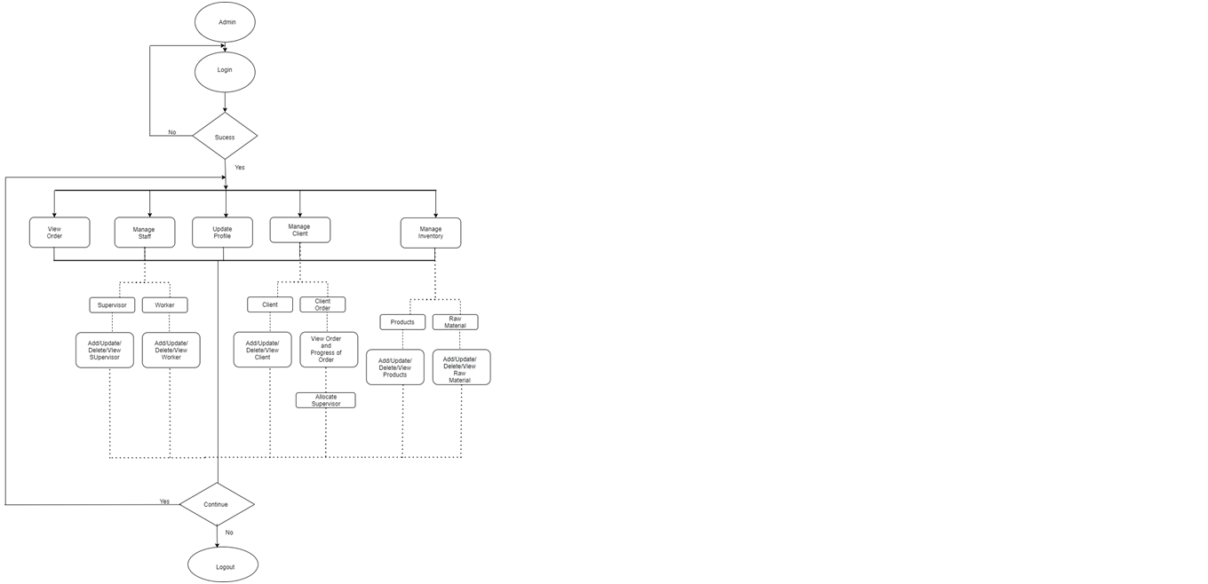
Flowchart
Admin

Slide 10
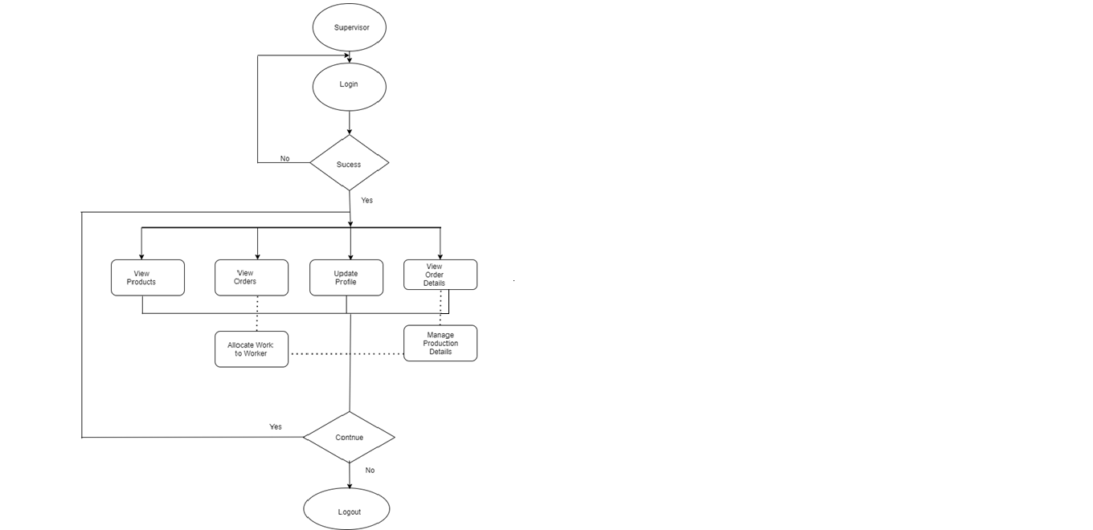
Supervisor

Slide 11
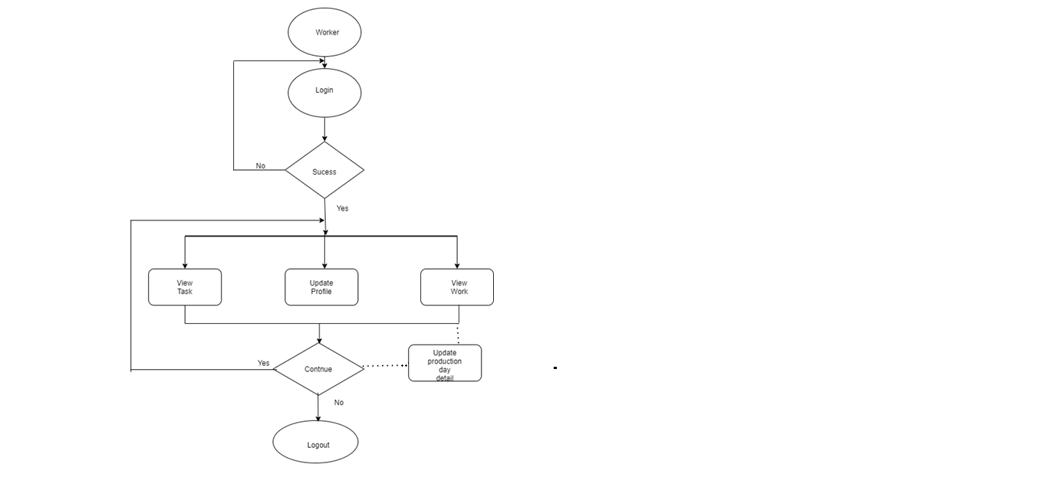
Worker

Slide 12
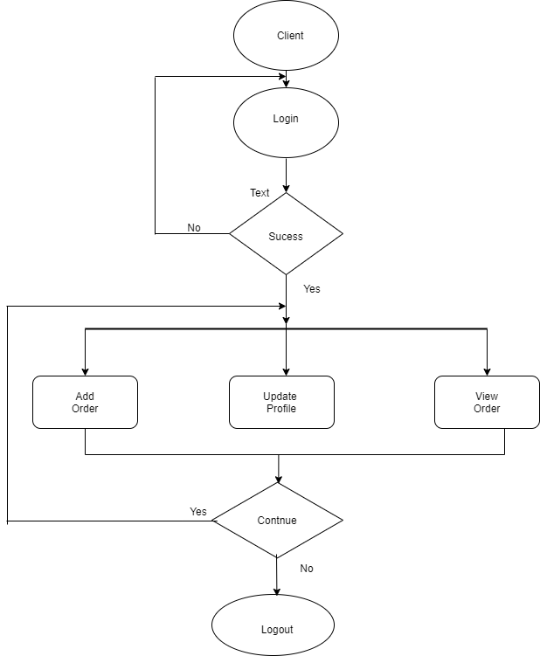
Client

Slide 13
Thank you

